Slide 1
Scientific Computing lecture # 2

Slide 2
Matrices
Matrices and Magic Squares
Entering Matrices
The Transpose
Subscripts
The Colon Operator

Slide 3
Matrix
The basic building block of MATLAB is the matrix.
A matrix is a rectangular array of numbers with m rows and n columns.
Special matrix is
Scalars : 1-by-1 matrices.
Vectors matrices with only one row or column.

Slide 4

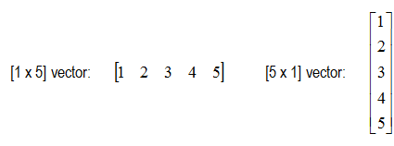
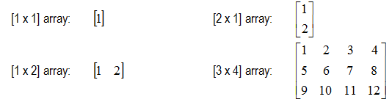
Matrix Examples:
Scalar
Vector
Array (Matrix)

Slide 5
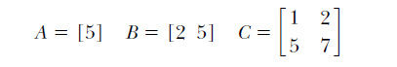
Matrix size:
The size of A is 1  1
Size of B is 1  2
Size of C is 2  2
Array’s size is (number of rows  number of columns)

Slide 6
Entering Matrices
You can enter matrices into MATLAB in several different ways:
• Enter an explicit list of elements. • Load matrices from external data files. • Generate matrices using built-in functions.
Entering a list of elements as matrix.
• Separate the elements of a row with blanks or commas.
• Use a semicolon, ; , to indicate the end of each row.
• Surround the entire list of elements with square brackets ,[ ].

Slide 7
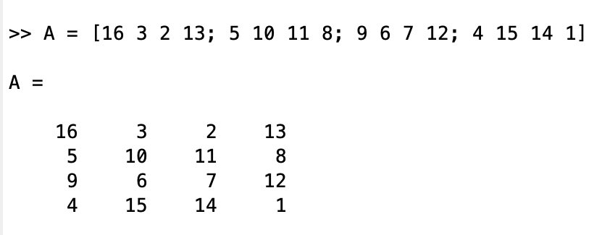
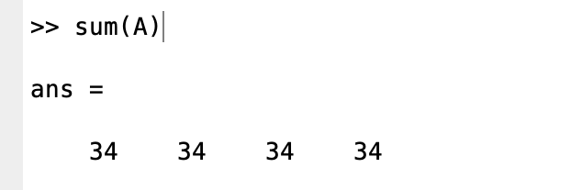
Entering Matrices
Example:
A = [16 3 2 13; 5 10 11 8; 9 6 7 12; 4 15 14 1]
MATLAB displays:
A is a magic square matrix which take the sum along any column or row, or along either of the two diagonals, you will always get the same number.
Let us verify that using Matlab: sum(A)

Slide 8
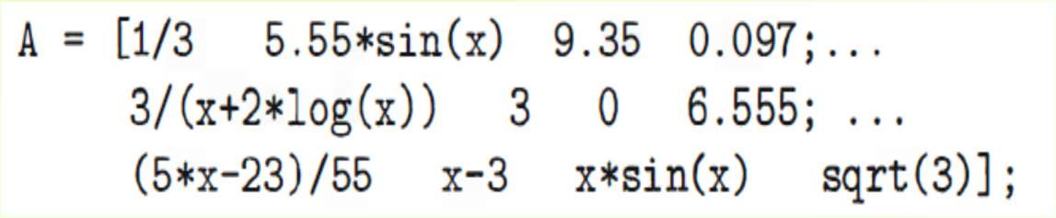
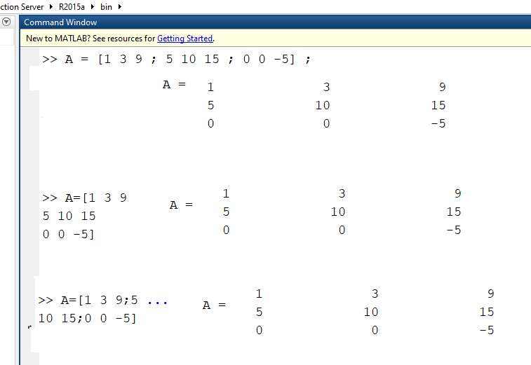
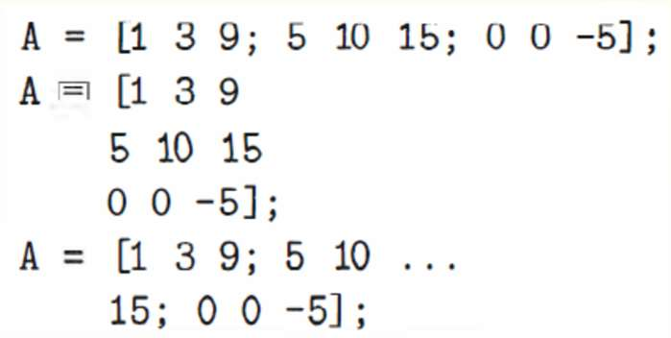
Entering Matrices
Continuation
The following commands give the same results: A is 3*3 matrix

Slide 9
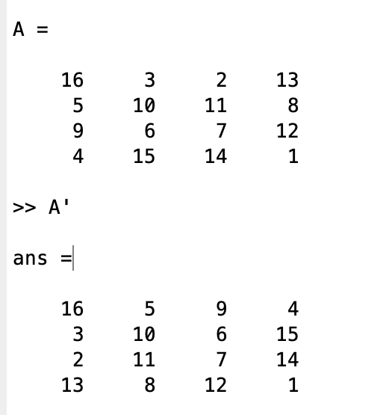
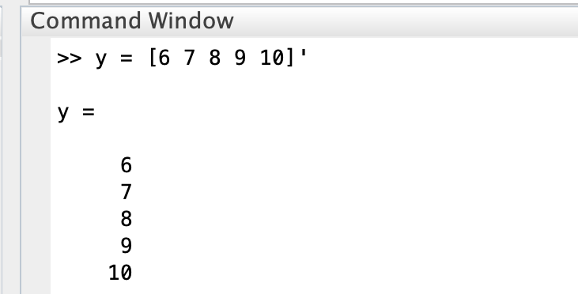
The Transpose
The transpose operation is denoted by single quote, ‘.
It flips a matrix about its main diagonal and it turns a row vector into a column vector.
Transpose a matrix
Transpose a row vector

Slide 10
Basic things to keep in mind
Where to type commands:
All MATLAB commands or expressions are entered in the command window at the MATLAB prompt (» ).
How to execute commands :
To execute a command or statement , you must press return or enter at the end.

Slide 11
Subscripts
You can refer to a particular entry in a matrix by using parentheses.
The element in row i and column j of A is denoted by A(i,j).
For example, A(4,2)
the number in the fourth row and second column.
For matrix A, A(4,2) is 15.
Lets compute the sum of the elements in the fourth column of A, type
A(1,4) + A(2,4) + A(3,4) + A(4,4)
This produces
ans = 34

Slide 12
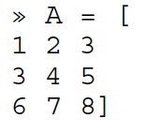
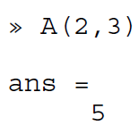
Subscripts
Example:
This means that A(2,3) refers to the number 5.
A(3,2) refers to the number 7, which is in the 3rd row, 2nd column.
NOTE:
If you try to use the value of an element outside of the matrix, it is an error:
t = A(4,5)
Index exceeds matrix dimensions.

Slide 13
The Colon Operator
The colon, : , is one of the most important MATLAB operators.
It occurs in several different forms. It can create vectors, subscript arrays.
The expression 1:10
is a row vector containing the integers from 1 to 10:
1 2 3 4 5 6 7 8 9 10
The expression 100:-7:50
is a row vector containing the integers from 100 to 50 by increment -7:
100 93 86 79 72 65 58 51

Slide 14
The Colon Operator
x = j:k creates a vector x with elements [j,j+1,...,k].
x = j:i:k creates a regularly vector x using i as increment step between elements.
A(:,n) is the nth column of matrix A.
A(m,:) is the mth row of matrix A.
A(:) reshapes all elements of A into a single column vector.

Slide 15
The Colon Operator
The colon by itself refers to all the elements in a row or column of a matrix
The keyword end refers to the last row or column.
sum(A(:,end))
computes the sum of the elements in the last column of A which is 34 as A is magic matrix.

Slide 16
Test your self
Let:
Which the value of
A(2,3) =
A(1, :) =
A(:, 3) =
A(:, 1:2:4) =
A(: ) =
A =
2 9 -3 10
-4 13 1 6

Slide 17
The magic Function
MATLAB actually has a built-in function that creates magic squares of almost any size, this function is named magic:
B = magic(4)
B= 16 2 3 13
5 11 10 8
9 7 6 12
4 14 15 1

Slide 18
Expressions
Like most other programming languages, MATLAB provides mathematical expressions, but unlike most programming languages, these expressions involve entire matrices.
The building blocks of expressions are
Variables
Numbers
Operators
Functions

Slide 19
Variables
MATLAB does not require any type declarations or dimension statements
When MATLAB encounters a new variable name, it automatically creates the variable and allocates the appropriate amount of storage.
If the variable already exists, MATLAB changes its contents and, if necessary, allocates new storage.
For example, num_students = 25
creates a 1-by-1 matrix named num_students and stores the value 25 in its single element.
Variable names consist of a letter, followed by any number of letters, digits, or underscores.
MATLAB is case sensitive; it distinguishes between uppercase and lowercase letters. A and a are not the same variable.
To view the matrix assigned to any variable, simply enter the variable name.

Slide 20
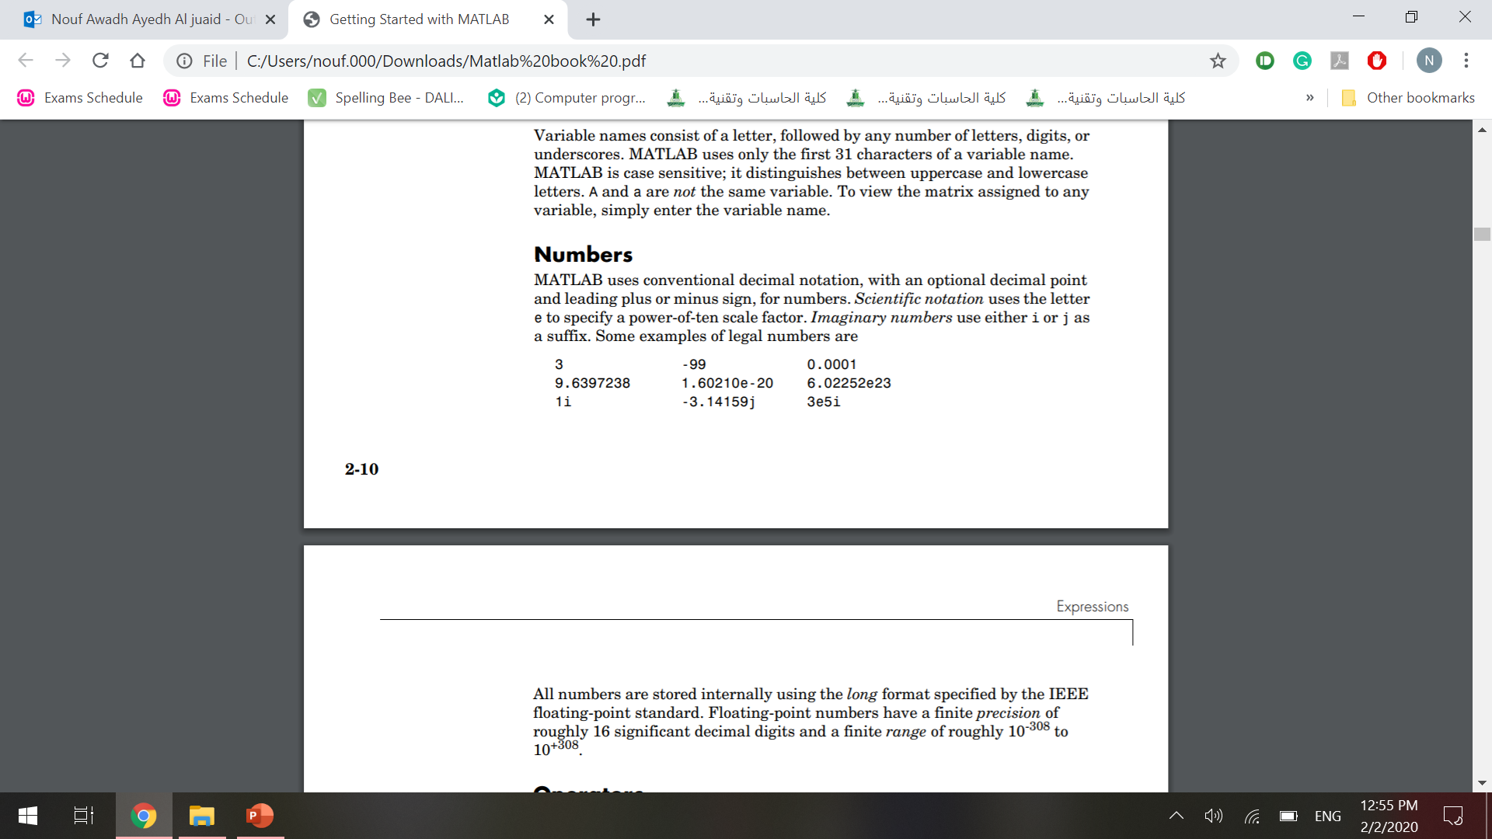
Numbers
MATLAB uses conventional decimal notation, with an optional decimal point and leading plus or minus sign, for numbers.
Scientific notation uses the letter e to specify a power-of-ten scale factor.
Imaginary numbers use either i or j as a suffix
Some examples of legal numbers are:
All numbers are stored internally using the long format

Slide 21
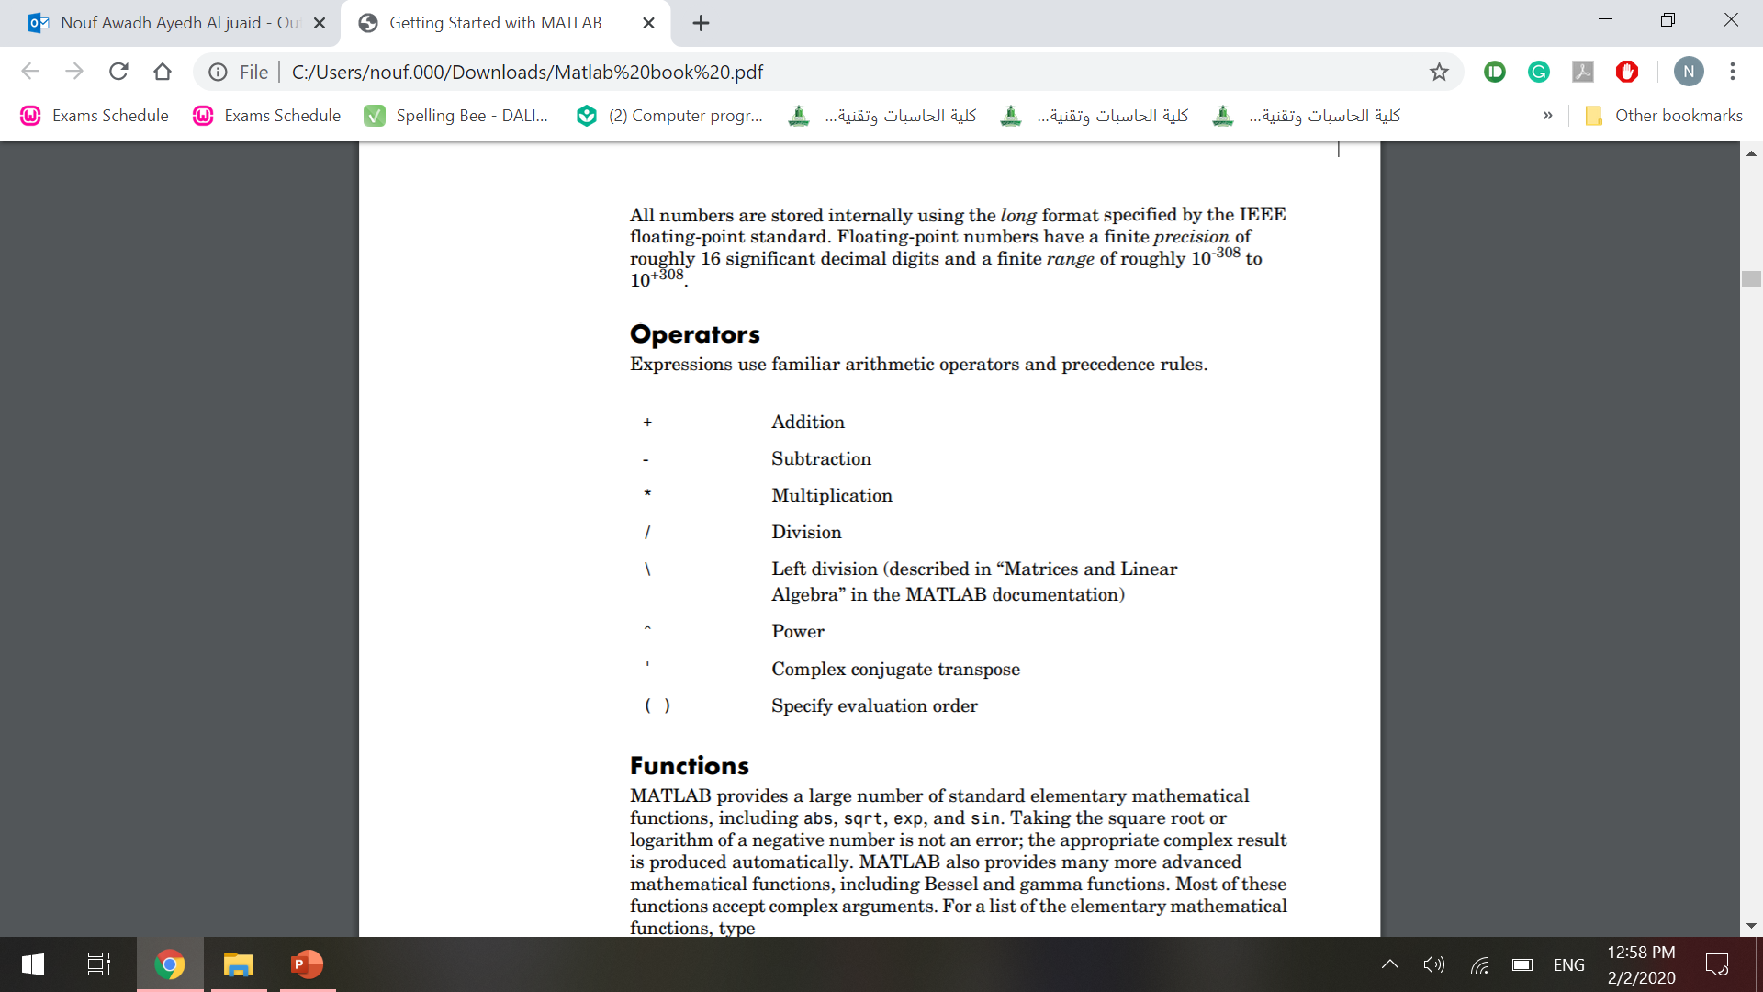
Operators
Expressions use familiar arithmetic operators and precedence rules.

Slide 22
Functions
MATLAB provides a large number of standard elementary mathematical functions, including abs, sqrt, exp, and sin.
MATLAB also provides many more advanced mathematical functions, including Bessel and gamma functions.
Most of these functions accept complex arguments.
For a list of the elementary mathematical functions, type :
help elfun
For a list of more advanced mathematical and matrix functions, type:
help specfun
help elmat

Slide 23
Functions
Some of the functions, like sqrt and sin, are built in.
Built-in functions are part of the MATLAB core so they are very efficient, but the computational details are not readily accessible. Other functions, like gamma and sinh, are implemented in M-files.
There are some differences between built-in functions and other functions. For example, for built-in functions, you cannot see the code. For other functions, you can see the code and even modify it if you want.

Slide 24
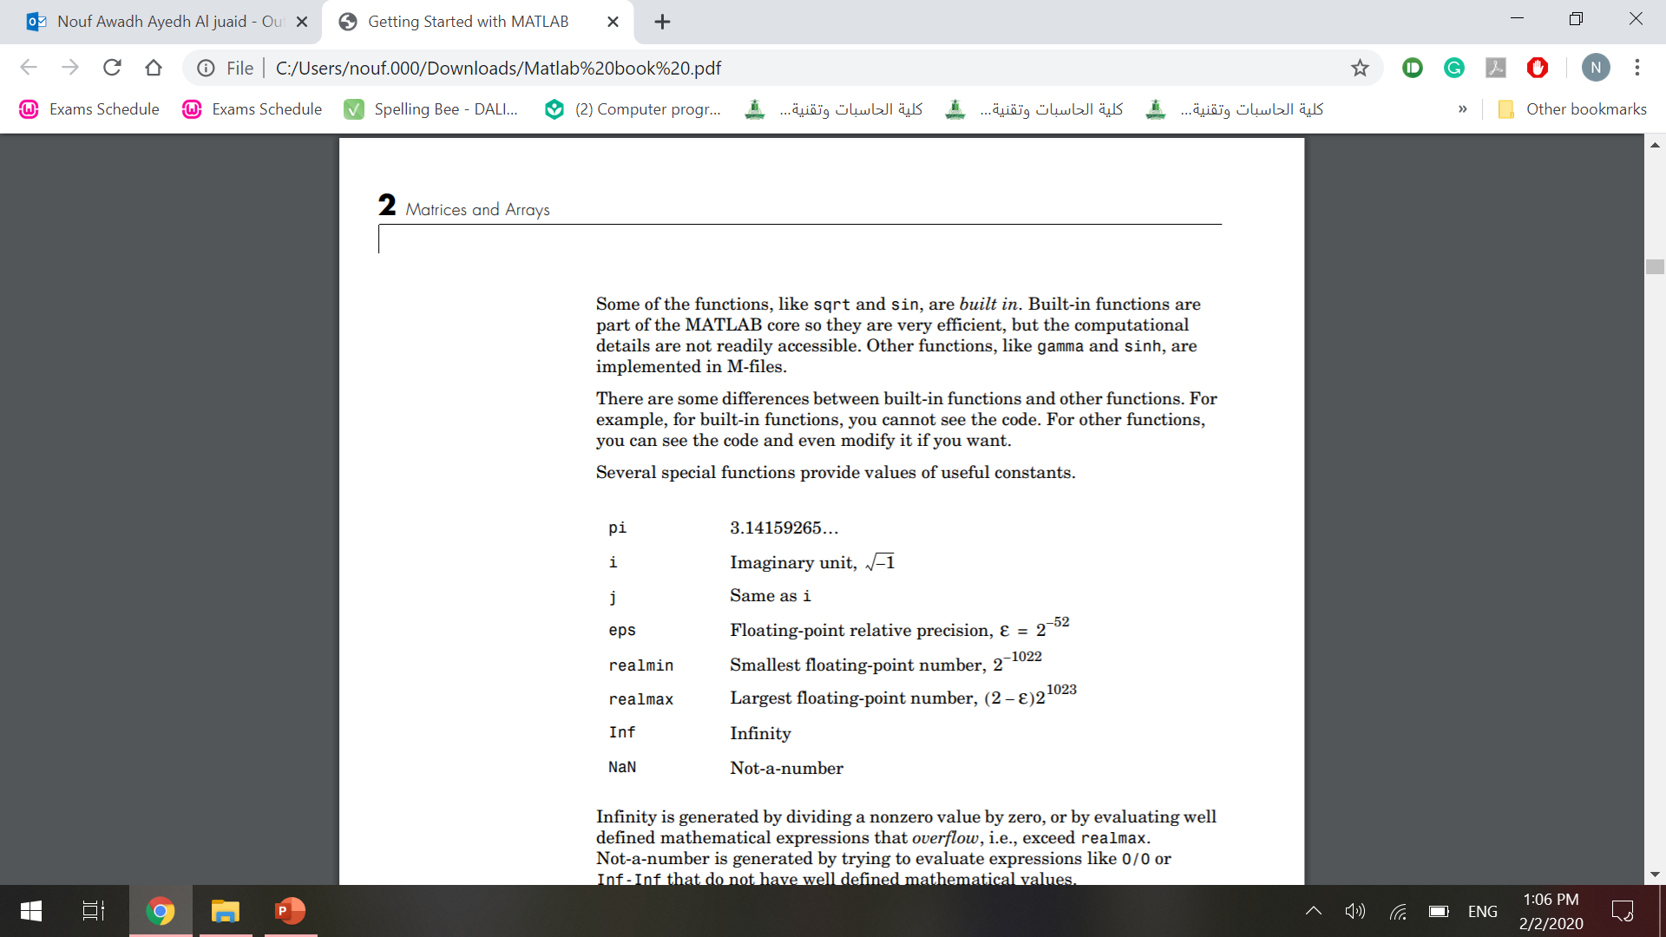
Functions
Several special functions provide values of useful constants.
The function names are not reserved. It is possible to overwrite any of them with a new variable,

Slide 25
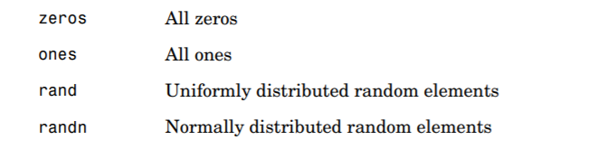
Working with Matrices
Generating Matrices
MATLAB provides four functions that generate basic matrices.

Slide 26
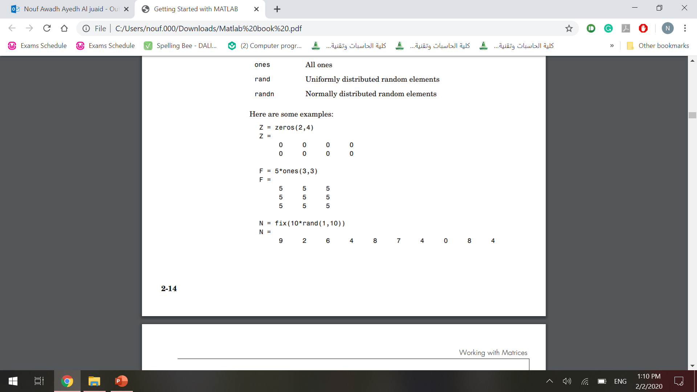
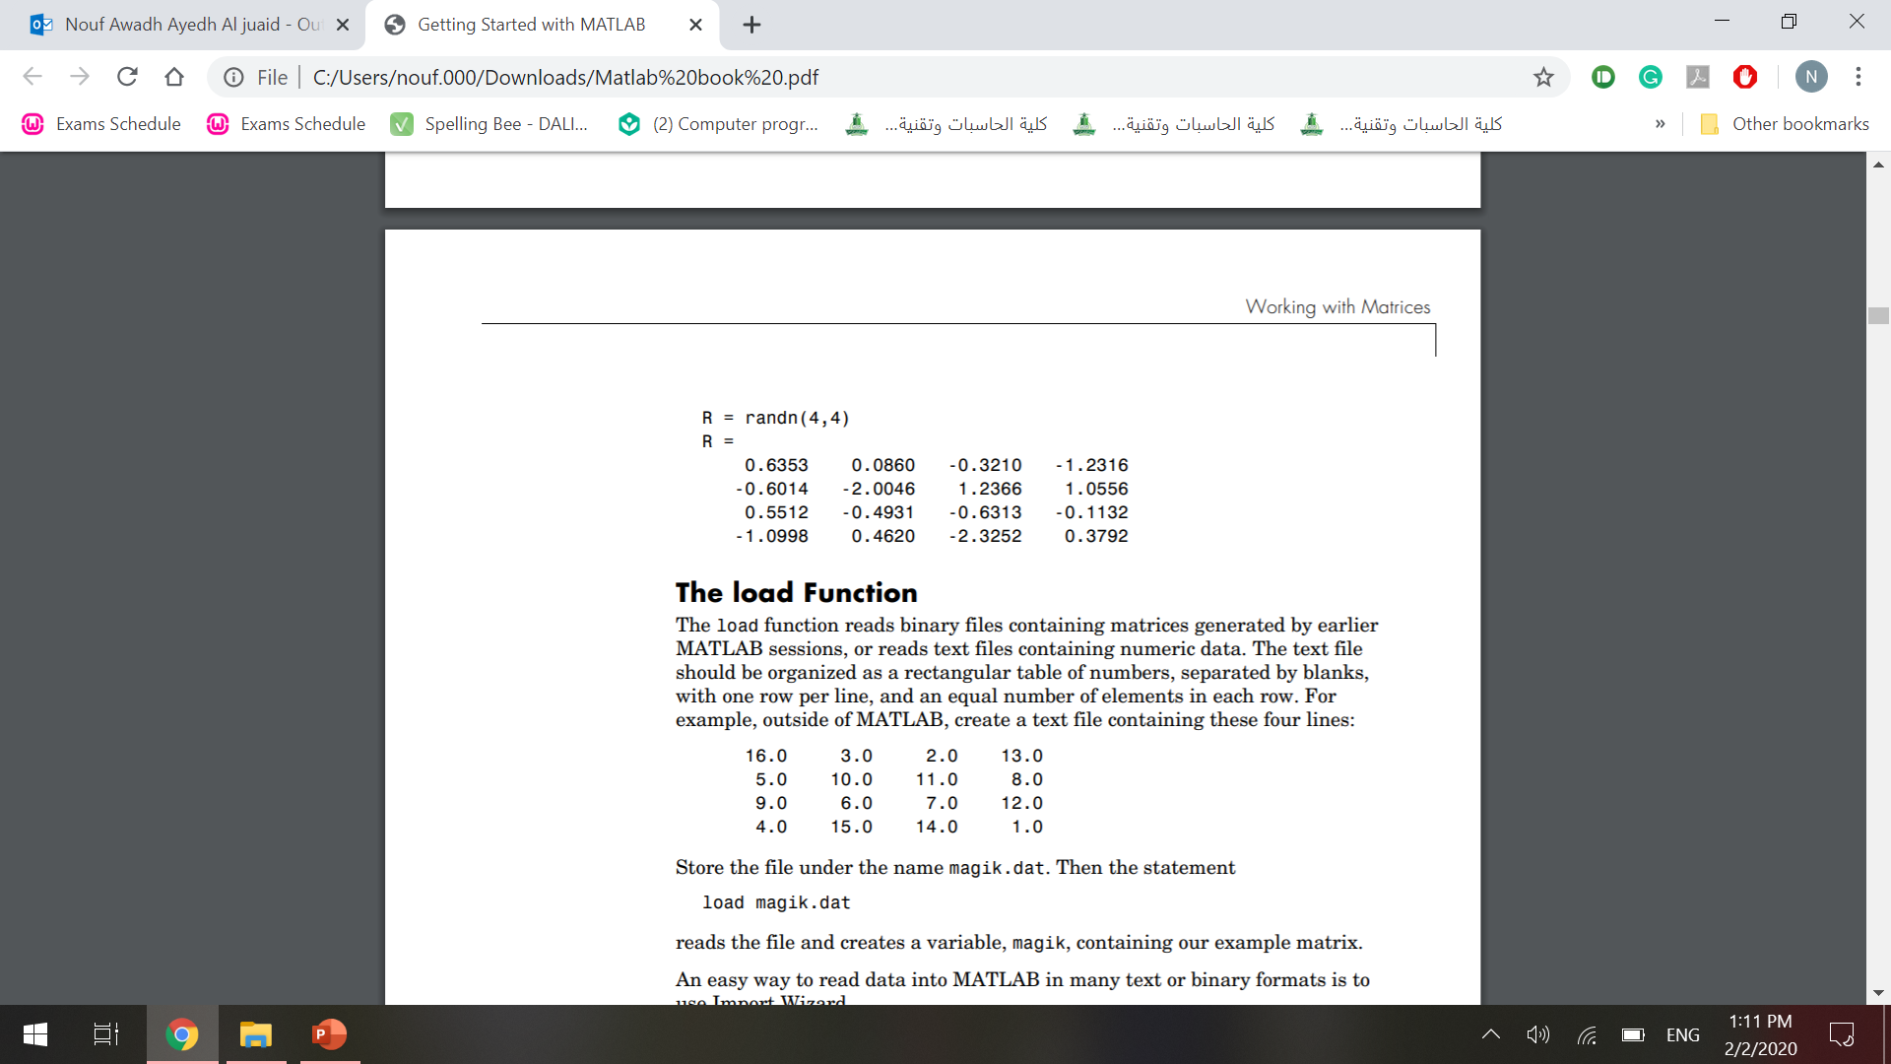
Here are some examples:

Slide 27
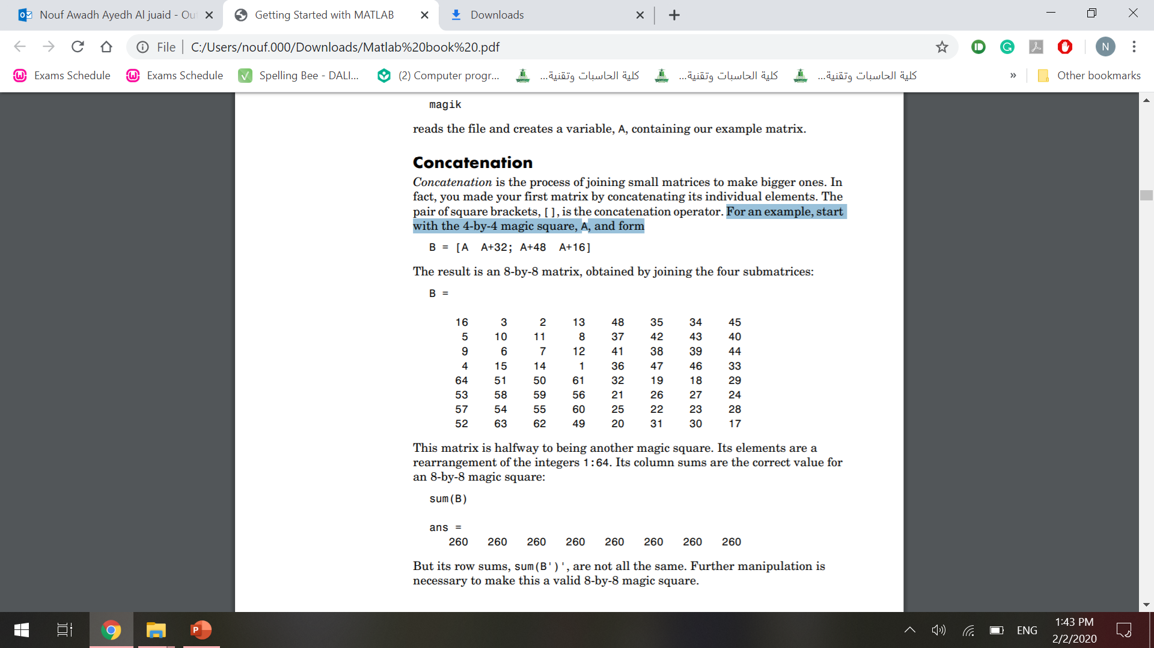
Concatenation
Concatenation is the process of joining small matrices to make bigger ones. In fact, you made your first matrix by concatenating its individual elements.
The pair of square brackets, [], is the concatenation operator.
For an example, start with the 4-by-4 magic square, A, and form

Slide 28
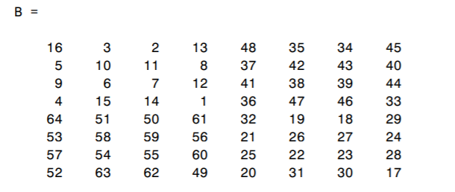
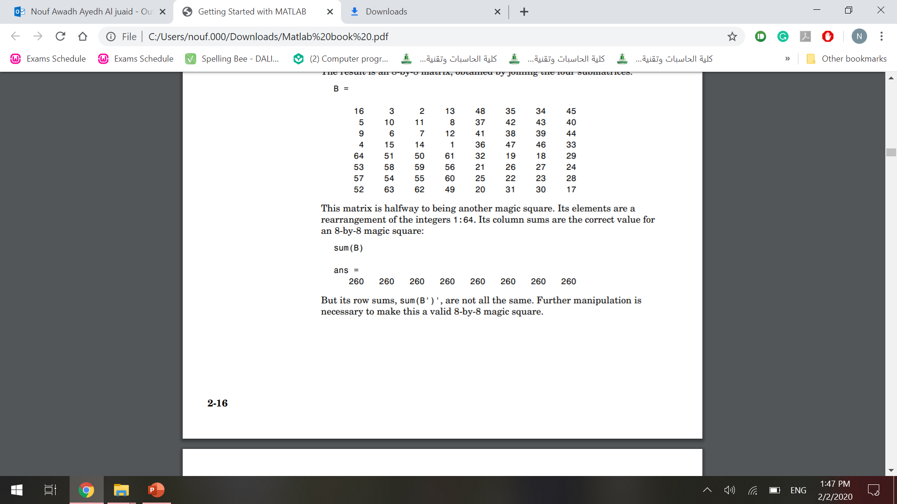
Concatenation
The result is an 8-by-8 matrix, obtained by joining the four submatrices:
sum(B) , Its column sums are the correct value for an 8-by-8 magic square, result in :

Slide 29
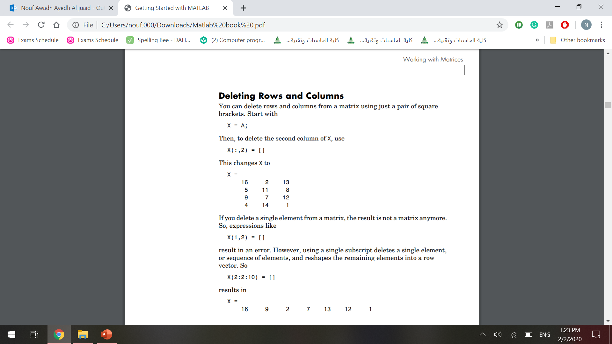
Deleting Rows and Columns
You can delete rows and columns from a matrix using just a pair of square brackets.
Start with
Then, to delete the second column of X, use
This changes X to

Slide 30

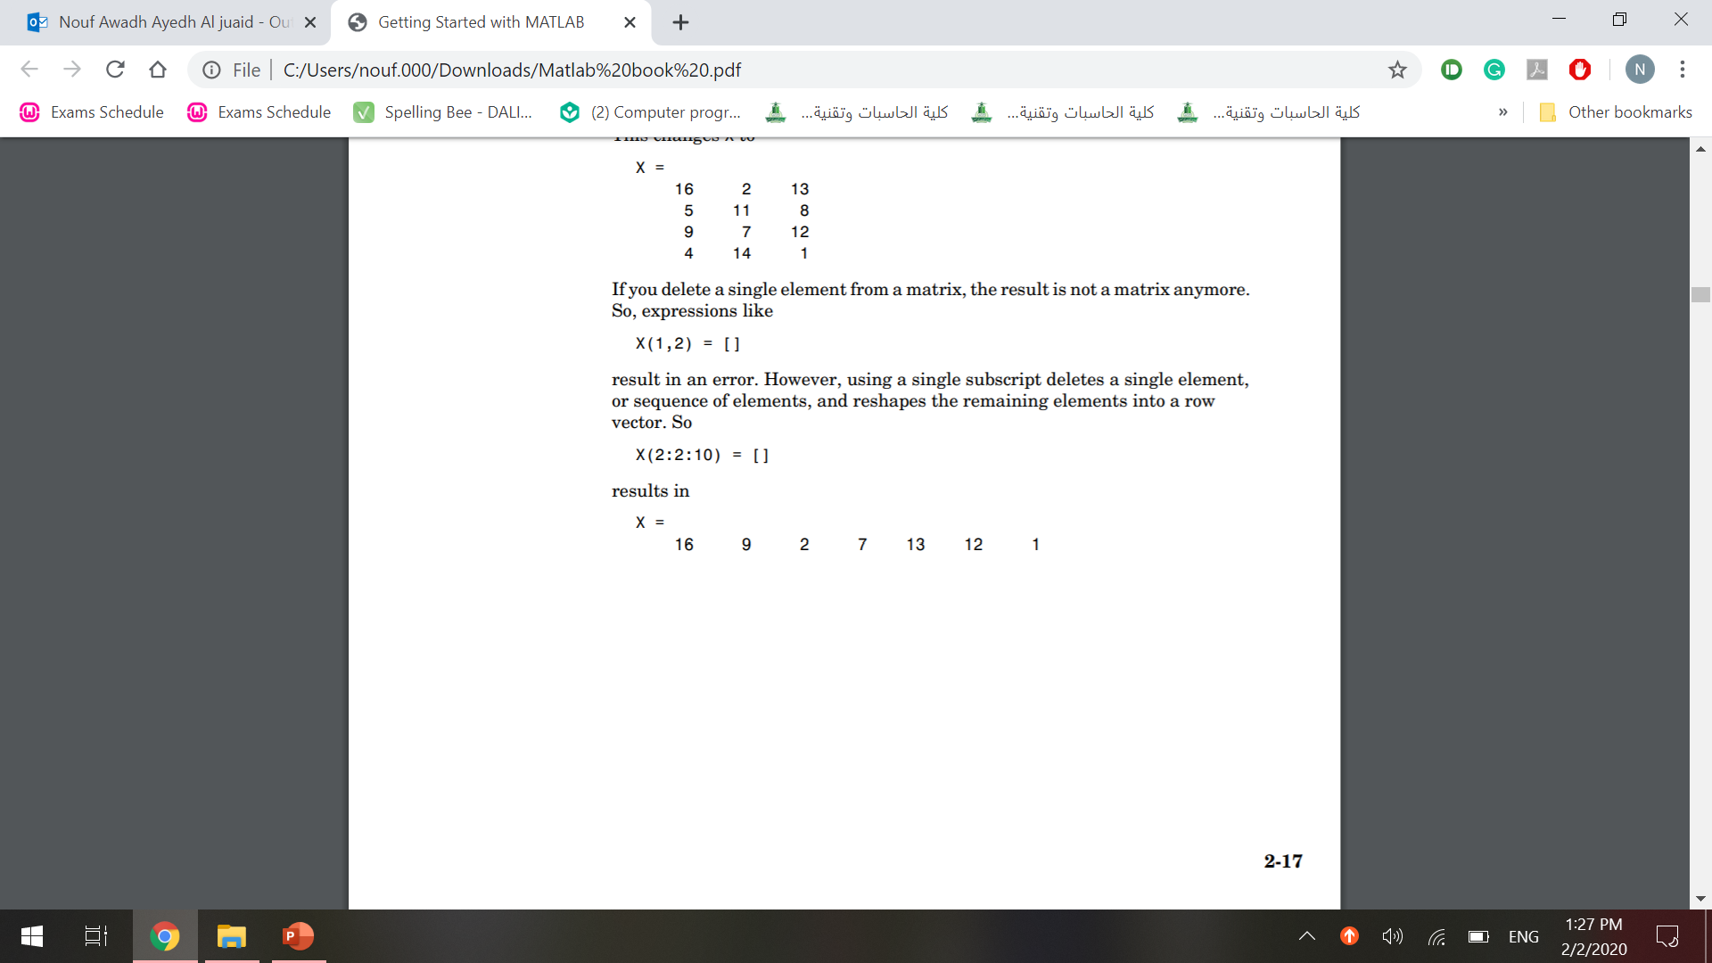
Deleting Rows and Columns
If you delete a single element from a matrix, the result is not a matrix anymore. So, expressions like
result in an error. However, using a single subscript deletes a single element, or sequence of elements, and reshapes the remaining elements into a row vector. So
Result in :

Slide 31
Any Questions

